Slide 2
3D blade model updating by coupling HAWC2 and ABAQUS
Maria Luz Castilla Mena (s212601@dtu.dk)
Notes:
Hi, I am Maria and I am going to present my master thesis topic: Evolution of blade cracks with wind turbine simulation tolos (this is a provisional titile, it needs to be discussed)

Slide 3
INDEX
From last meeting
Progress of the project
For the next meeting

Slide 4
From last meeting
Solve HAWC2 problems:
Short simulations take forever
Same results for highly different wind speeds
Apply 3 moments (Mx, My and Mz) at the same time in ABAQUS
Plot results in MATLAB
Make a restart .inp file to add a single load IN TOP OF the previous results (apply on the already deformed beam)
Double check if I am applying loads in top of previous situation

Slide 5
Progress of the project

Slide 6

Progress of the project
Solve HAWC2 problems:
Short simulations take forever – due to a special part Alan made regarding HAWC2 – MATLAB interface
Same results for highly different wind speeds – due to short time simulations (1 sec)
Apply 3 moments (Mx, My and Mz) at the same time in ABAQUS
Plot results in MATLAB
Make a restart .inp file to add a single load IN TOP OF the previous results (apply on the already deformed beam)
Double check if I am applying loads in top of previous situation

Slide 7
Challenges
When running 100 sec simulation in HAWC2: time increment varies!
10 sec simulation: time increment = 0.01, so as in ABAQUS
How to model a time increment in ABAQUS that varies the same as the .inp load files from HAWC2?
Coordinate system ABAQUS doesn’t match with the one in HAWC2
Need to make modifications to MATLAB code to:
Adapt it to 3 moments and 3 amplitudes
Run 2 iterations automatically

Slide 8
Results

Slide 9
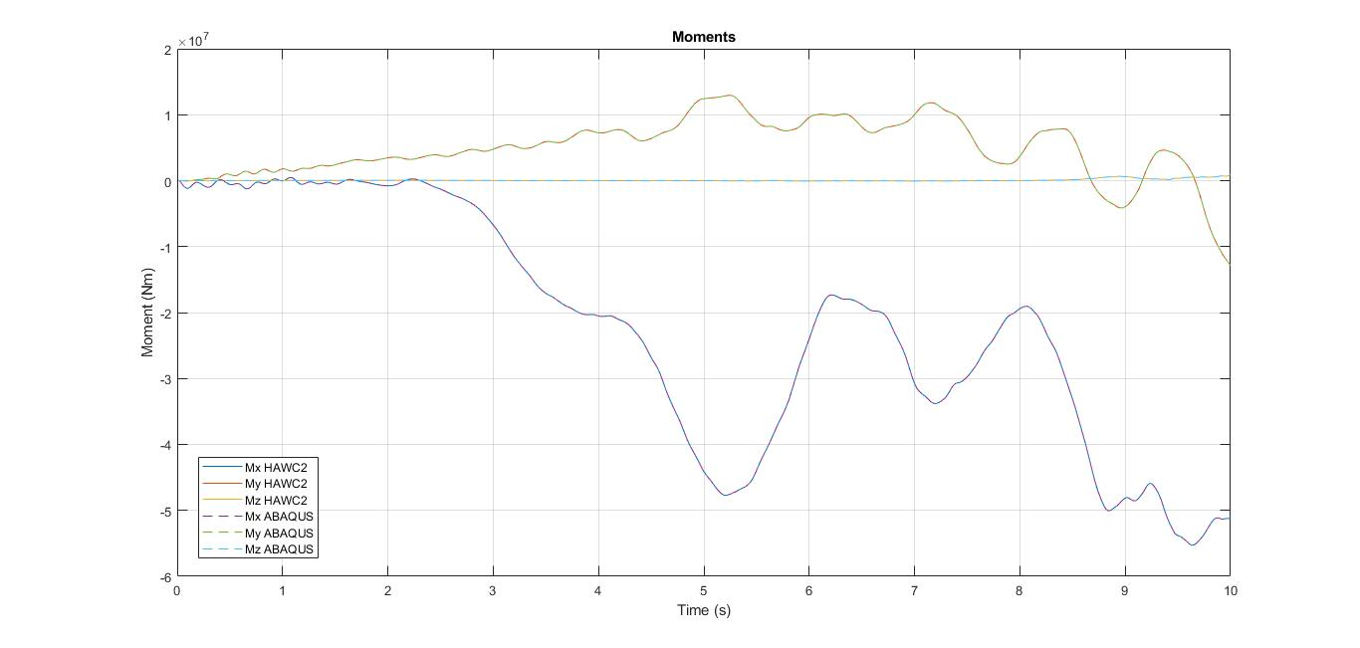
Job-1: 3 moments applied ABAQUS

Slide 10
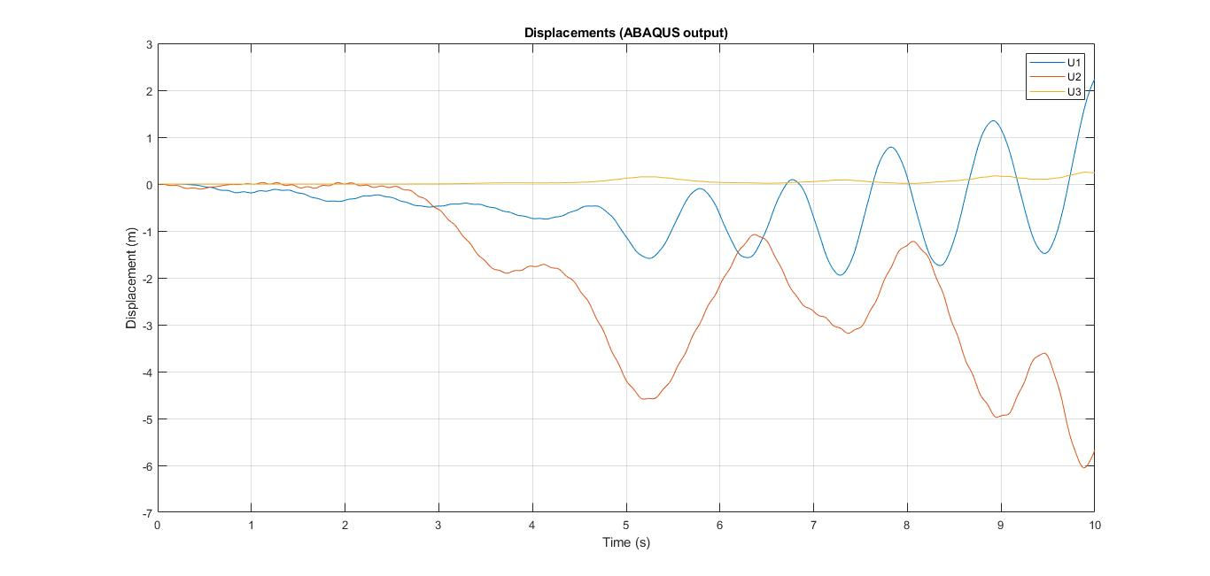
Job-1

Slide 11
Job-2
Main goal: to apply a different load on top of the previous job
Job-1: 3 moments applied: Mx, My, Mz
Job-2: 1 force applied on top of the previous job
Value of the moments at the end of Job-1 simulation:
Job-1
Time (s) | Vx (m/s) | Vy (m/s) | Vz (m/s) | Mx (Nm) | My (Nm) | Mz (Nm)
10 | 0 | 47.4202 | 0 | -5.1296 E7 | -1.2862 E7 | 8.5167 E5
ABAQUS
HAWC2

Slide 12
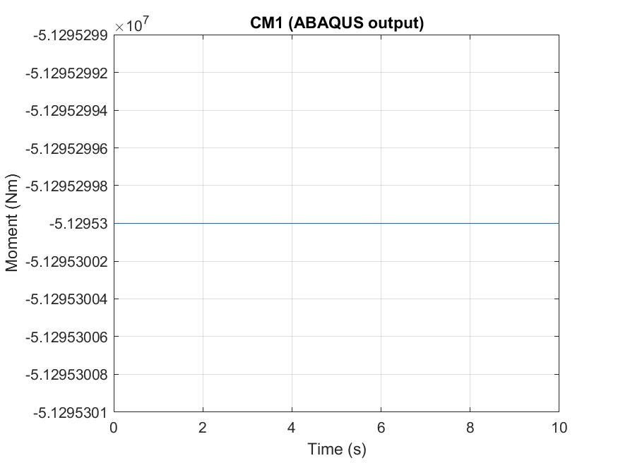
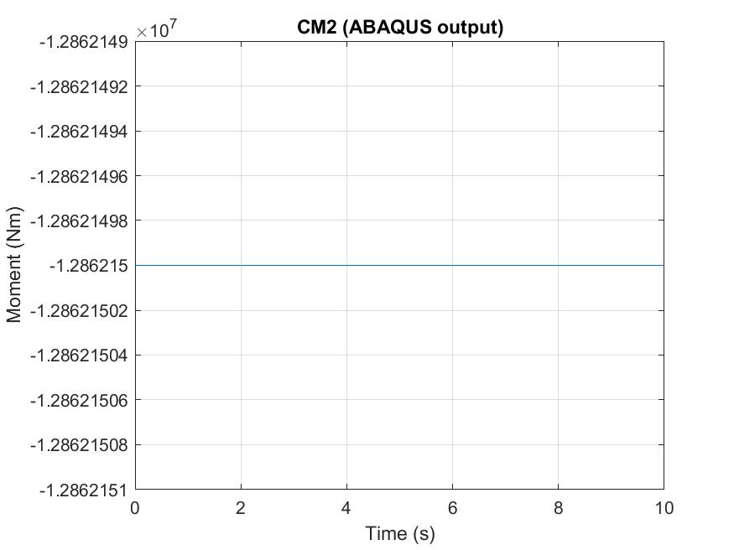
Job-2: Value of the moments
Job-1
Time (s) | Vx (m/s) | Vy (m/s) | Vz (m/s) | Mx (Nm) | My (Nm) | Mz (Nm)
10 | 0 | 47.4202 | 0 | -5.1296 E7 | -1.2862 E7 | 8.5167 E5
Job-2
Job-2

Slide 13
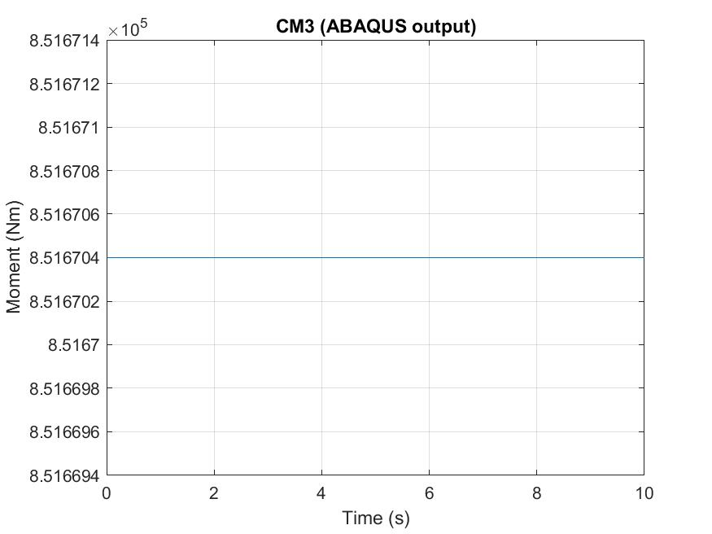
Job-2: Value of the moments
Job-1
Time (s) | Vx (m/s) | Vy (m/s) | Vz (m/s) | Mx (Nm) | My (Nm) | Mz (Nm)
10 | 0 | 47.4202 | 0 | -5.1296 E7 | -1.2862 E7 | 8.5167 E5
Job-2

Slide 14
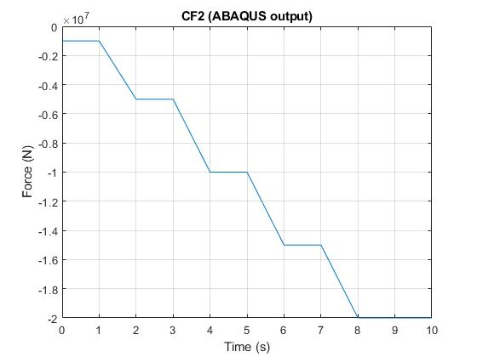
Job-2: New force applied

Slide 15
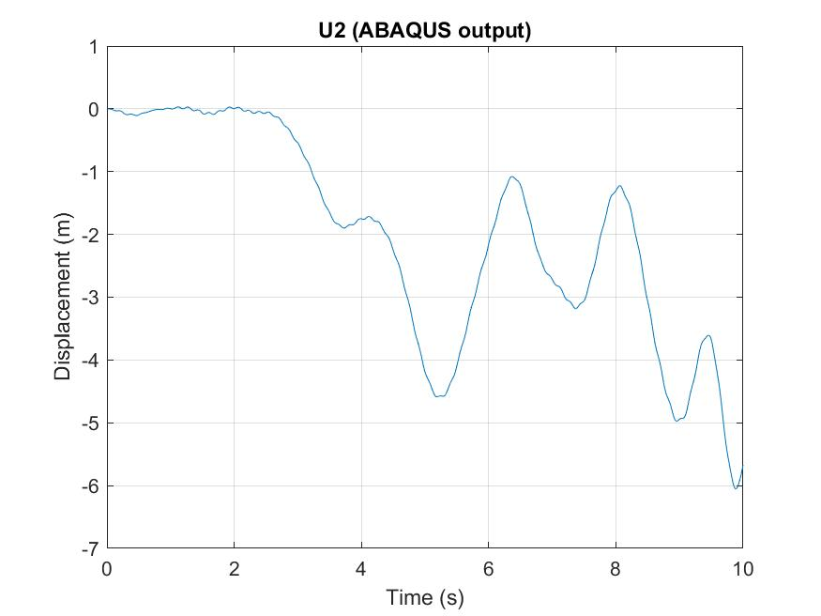
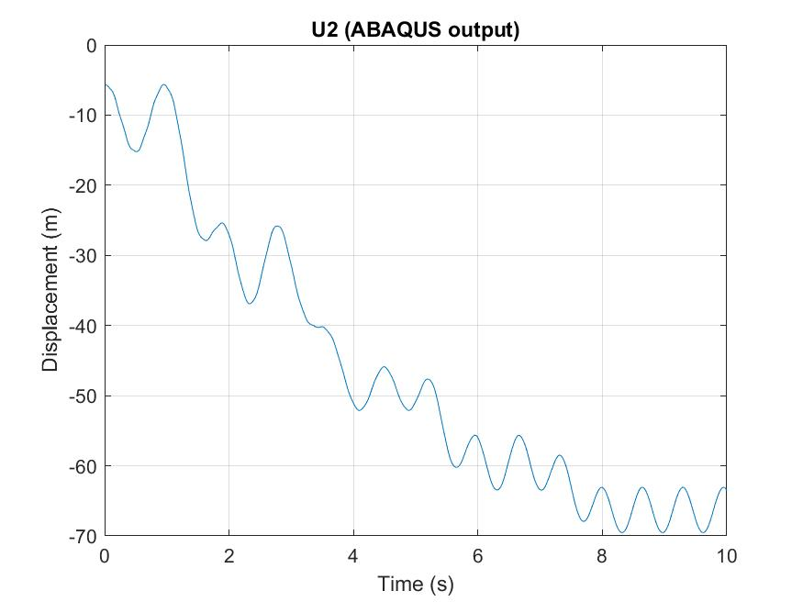
Job-2: Displacement Y direction
Job-1
Job-2

Slide 16
For next meeting…

Slide 17
For the next meeting
Create MATLAB code that generates a .txt file with all the information of all the iterations
Run different jobs automatically in MATLAB
Run several Jobs with different HAWC2 input
Suggestions?

Slide 18
Thoughts on the project
Ju’s reflections regarding updating structural parameters in HAWC2
Hard to accomplish
Won’t make significant difference
But… he is not taking into account that I will simulate a storm (high wind speeds, outside the operational confort zone of wind turbines)
His suggestion: Show in my thesis that updating structural parameters does make a difference or not in the whole loop time simulation

